Slide 1
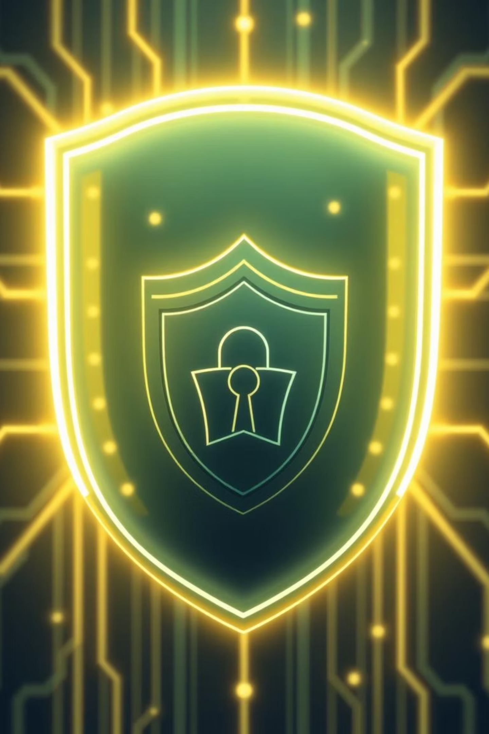
Strengthening Our Shield: Phishing Awareness Training
In today's interconnected world, cyber threats are constantly evolving. Phishing attacks remain a significant risk to our organization, but with your help, we can build a stronger defense.

Slide 2

Today's Agenda
1
Understanding Phishing
What it is and how it works.
2
Common Tactics & Red Flags
Learning to spot suspicious emails and links.
3
Reporting & Response
What to do if you suspect a phishing attempt.
4
Best Practices for Prevention
Simple steps to enhance your personal and organizational security.

Slide 3
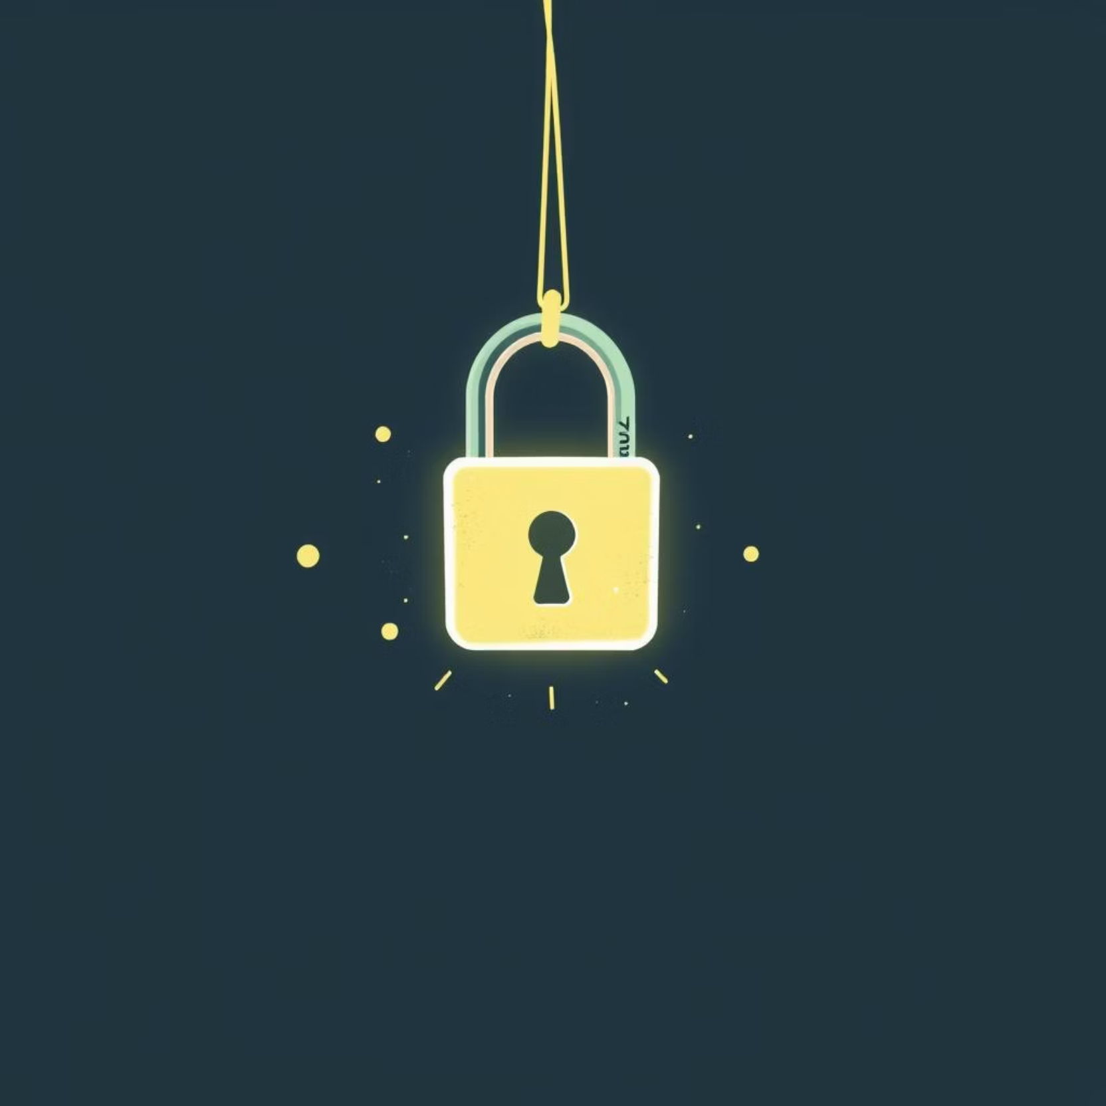
What is Phishing?
Phishing is a type of cyberattack where malicious actors attempt to trick individuals into revealing sensitive information, such as passwords, credit card numbers, or other personal data.
They often impersonate trusted entities like banks, government agencies, or even colleagues to gain your trust. These attacks primarily occur via email, but can also use text messages (smishing) or phone calls (vishing).

Slide 4





Common Phishing Tactics
Email Impersonation
Emails from fake senders, often mimicking known companies or individuals, to create a sense of urgency or authority.
Malicious Links
Links that redirect to fake websites designed to steal credentials or download malware.
Urgent Requests
Demands for immediate action, such as password resets or financial transfers, under the guise of an emergency.
Fake Offers/Prizes
Promises of rewards or discounts that require personal information to claim.

Slide 5

Identifying Red Flags
Generic Greetings
Emails lacking personalization, like "Dear Customer."
Spelling & Grammar Errors
Unprofessional language or numerous typos.
Suspicious Attachments
Unexpected files, especially with unusual extensions.
Unusual Sender Address
Email addresses that don't match the supposed sender's domain.

Slide 6



What to Do If You Suspect Phishing
Report Immediately
Forward suspicious emails to IT security without clicking any links or downloading attachments.
Do Not Engage
Avoid replying or interacting with the sender in any way.
Change Passwords
If you accidentally clicked a link or provided information, change all relevant passwords immediately.

Slide 7
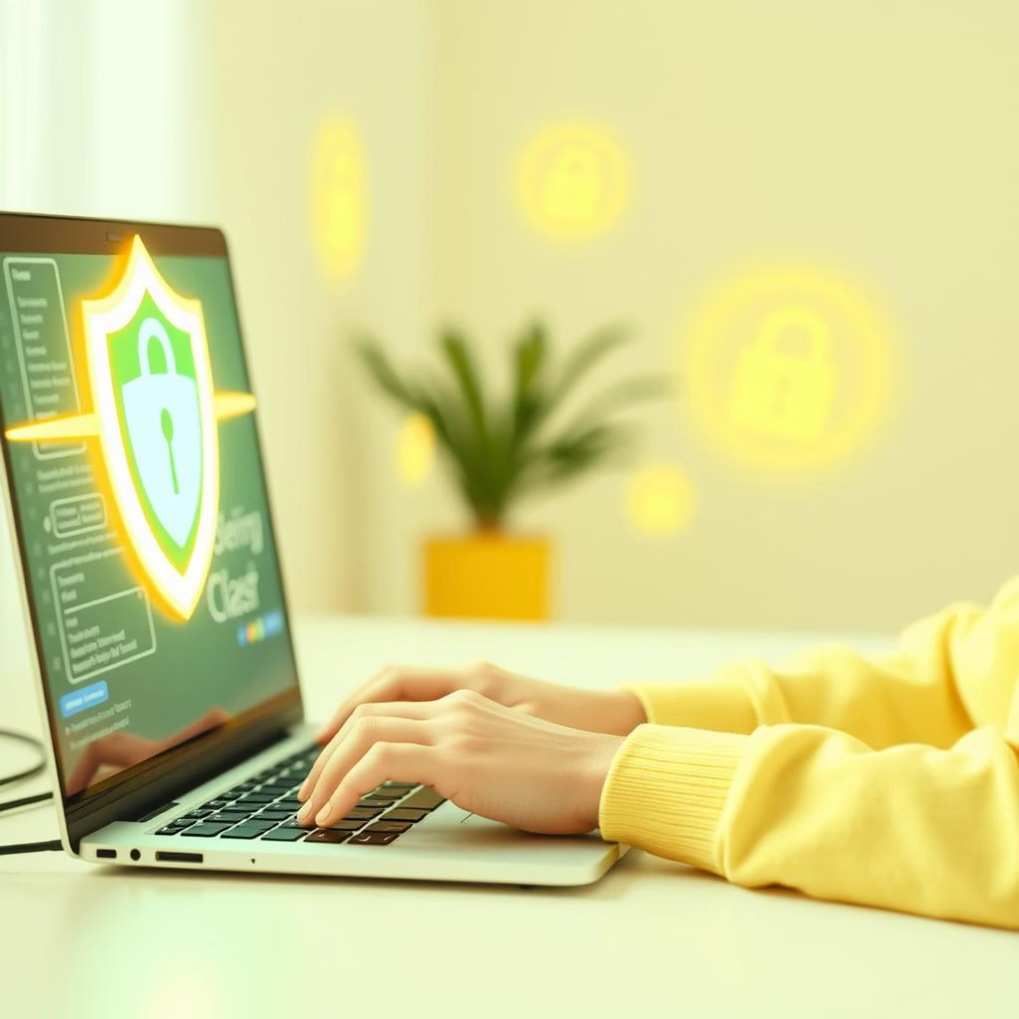
Best Practices for Prevention
Verify Sender: Always check the sender's email address for authenticity.
Hover Before Clicking: Mouse over links to see the true URL before clicking.
Use Strong Passwords: Implement complex, unique passwords for all accounts.
Enable MFA: Utilize Multi-Factor Authentication whenever possible.
Regular Updates: Keep software and operating systems up to date to patch vulnerabilities.

Slide 8




Key Takeaways & Next Steps
Stay Vigilant
You Are Our First Line of Defense
Report & Collaborate
Phishing threats are constant, so continuous awareness is crucial.
Don't hesitate to report suspicious activity to IT security.
Your vigilance directly contributes to our collective security.
Thank you for your attention and commitment to our organization's security.

